Slide 1
An overview of Semantic Web Languages and Technologies

Slide 2
Semantic Web Technologies
W3C “recommendations”
RDF, RDFS, RDFa, OWL, SPARQL, RIF, R2R, etc…
Common tools and systems -- commercial, free and open sourced
Ontology editors, triple stores, reasoners, etc.
Common ontologies and data sets
Foaf, DBpedia, SKOS, PROV, etc.
Infrastructure systems
Search, ontology metadata, linking services
Non W3C: Schema.org, Freebase, …

Slide 3
Common KR languages
Knowledge representation and reasoning (KR&R) has always been an important part of AI & other disciplines
Many approaches have been developed, implemented and evolved since the 1960s
Most were one-offs, used only by their developers
Starting in the 1990s, there was an interest in developing a common KR language to support knowledge reuse and distributed KB systems
The Semantic Web languages (e.g., OWL) are a current generation of this idea
There are currently no other widely used KR languages

Slide 4
Questions
Database (DB) vs. knowledge base (KB)?
TL;DR: DBs have facts, KBs have general knowledge and (maybe) facts
DBs typically have simple schemas (knowledge) and lots of data (facts)
KBs have complex schemas (aka ontologies) and may or may not have a lot of instances (data)
KBs support inference, e.g.,
parent(?x,?y) => person(?x), person(?y), child(?y,?x), older(?x,?y), ?x≠?y
Parent(john,mary) => person(john), child(mary,john), …

Slide 5
Questions
What’s the impact of using different structures to represent data or knowledge?
Natural language
Program code
Relations vs. graphs vs. objects
Logic vs. rules vs. procedures
Neural networks
Tensors

Slide 6
Questions
What’s our “semantic” model for facts and knowledge?
Classical logic is a common choice
man(socrates), ∀x man(x) => mortal(x)
Classical logic has limitations: facts and relations and “rules” are either (always) True or False for all time
May need to represent and reason with probabilistic or fuzzy facts and knowledge
May need to handle dynamic facts or knowledge

Slide 7
Semantic Web Technologies
Basic approach uses classical logic for underlying semantics
+ Simple, well understood, good reasoning algorithms
- No probabilities, adding extensions (e.g., for time) adds complexity
Knowledge represented as a graph
+ Simple, good tool support - May be too simple

Slide 8
Two Semantic Web Notions
The semantic web
Idea of a web of machine understandable information
Agnostic about the technology used to support it
May involve more AI (e.g., NLP, machine learning)
Human end users in the center
The Semantic Web
Current vision of a semantic web as defined by the W3C community: a Web of data
Using W3C supported standards, i.e., RDF, OWL, SPARQL, XML, RIF, etc.
By machines for machines with human-oriented applications on top

Slide 9
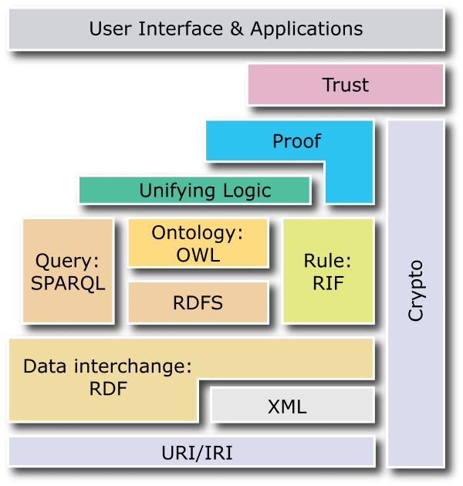
W3C Semantic Web Stack

Slide 10
RDF is the first SW language
Graph
XML Encoding
RDF
Data Model
<rdf:RDF ……..>
<….>
<….>
</rdf:RDF>
Good for people, viz, graph DBMS
Good for
Machine Processing
Triples
stmt(docInst, rdf_type, Document)
stmt(personInst, rdf_type, Person)
stmt(inroomInst, rdf_type, InRoom)
stmt(personInst, holding, docInst)
stmt(inroomInst, person, personInst)
JSON Encoding
{"@context":{
"name": "http://…/name",
"Person": "http://…/Person"}
"@type": "Person",
"name": "Markus Lanthaler"
}
Good For Reasoning and Databases
RDF is a simple language for building graph based representations

Slide 11
The RDF Data Model
An RDF document is an unordered collection of statements, each with a subject, predicate and object (aka triples)
A triple can be thought of as a labelled arc in a graph
Statements describe properties of web resources
Resource are objects that can be pointed to by a URI:
a document, a picture, a paragraph on the Web, …
E.g., http://umbc.edu/~finin/cv.html
a book in the library, a real person (?)
isbn://5031-4444-3333
Properties themselves are also resources (URIs)

Slide 12
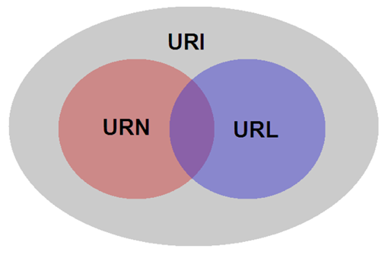
URIs are a foundation
URI = Uniform Resource Identifier
"The generic set of all names/addresses that are short strings that refer to resources"
URLs (Uniform Resource Locators) are a subset of URIs, used for resources that can be accessed on the web
URIs look like URLs, often with fragment identifiers pointing to a document part:
http://foo.com/bar/mumble.html#pitch

Slide 13
URIs are a foundation
URIs are unambiguous, unlike natural language terms -- the web provides a global namespace
We can use a URI to denote something, e.g., a concept, entity, event or relation
We usually assume references to the same URI are to the same thing

Slide 14
What does a URI mean?
Sometimes URIs denote a web resource
http://umbc.edu/~finin/finin.jpg denotes a file
We can use RDF to make assertions about the resource, e.g., it’s an image and depicts a person with name Tim Finin, …
Sometimes concepts in the external world
E.g., http://umbc.edu/ denotes a particular university located in Baltimore
This is done by social convention
Cool URIs don’t change
http://www.w3.org/Provider/Style/URI

Slide 15
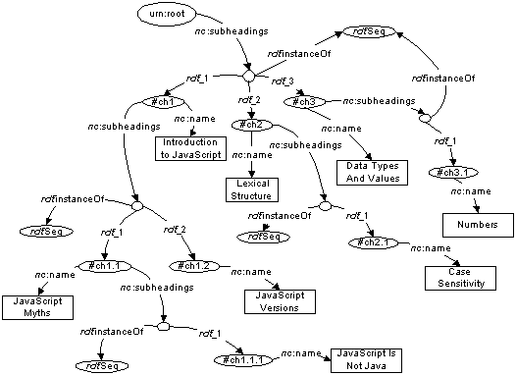
The RDF Graph
An RDF document is an unordered collection of triples
The subject of one triple can be the object of another
The result is a directed, labelled graph
A triple’s object can also be a literal, e.g., a string
Graphs are simpler that relational tables or objects
This is both a plus and a minus

Slide 16
Simple RDF Example
http://umbc.edu/ ~finin/talks/idm02/
dc:Title
“Intelligent Information Systems on the Web”
dc:Creator
bib:Aff
http://umbc.edu/
bib:email
bib:name
“Tim Finin”
“finin@umbc.edu”

Slide 17
Serialization
A graph is an abstract model, we’ll need to serialize it as text for many reasons, e.g., display, editing, exchange, …
Multiple standard RDF serializations
Most important: XML, Turtle, ntriples, JSON-LD
Most Semantic Web tools can read or write in any of these serializations

Slide 18
XML encoding for RDF
<rdf:RDF xmlns:rdf="http://www.w3.org/1999/02/22-rdf-syntax-ns#"
xmlns:dc="http://purl.org/dc/elements/1.1/"
xmlns:bib=http://daml.umbc.edu/ontologies/bib/>
<rdf:Description rdf:about="http://umbc.edu/~finin/talks/idm02/">
<dc:title>Intelligent Information Systems on the Web</dc:title>
<dc:creator>
<rdf:Description>
<bib:Name>Tim Finin</bib:Name>
<bib:Email>finin@umbc.edu</bib:Email>
<bib:Aff rdf:resource="http://umbc.edu/" />
</rdf:Description>
</dc:creator>
</rdf:Description>
</rdf:RDF>

Slide 19
Note the prefix declarations
<rdf:RDF xmlns:rdf="http://www.w3.org/1999/02/22-rdf-syntax-ns#"
xmlns:dc="http://purl.org/dc/elements/1.1/"
xmlns:bib=http://daml.umbc.edu/ontologies/bib/>
<rdf:Description rdf:about="http://umbc.edu/~finin/talks/idm02/">
<dc:title>Intelligent Information Systems on the Web</dc:title>
<dc:creator>
<rdf:Description>
<bib:Name>Tim Finin</bib:Name>
<bib:Email>finin@umbc.edu</bib:Email>
<bib:Aff rdf:resource="http://umbc.edu/" />
</rdf:Description>
</dc:creator>
</rdf:Description>
</rdf:RDF>

Slide 20
Note the prefix declarations
<rdf:RDF xmlns:rdf="http://www.w3.org/1999/02/22-rdf-syntax-ns#"
xmlns:dc="http://purl.org/dc/elements/1.1/"
xmlns:bib=http://daml.umbc.edu/ontologies/bib/>
<rdf:Description rdf:about="http://umbc.edu/~finin/talks/idm02/">
<dc:title>Intelligent Information Systems on the Web</dc:title>
<dc:creator>
<rdf:Description>
<bib:Name>Tim Finin</bib:Name>
<bib:Email>finin@umbc.edu</bib:Email>
<bib:Aff rdf:resource="http://umbc.edu/" />
</rdf:Description>
</dc:creator>
</rdf:Description>
</rdf:RDF>
Makes it easy to include terms from three different “vocabularies”:
rdf for terms that are part of its representation language (e.g., rdf:type)
dc for terms from the Dublin Core vocabulary developed by librarians
bib for terms from a bibliography vocabulary developed at UMBC

Slide 21
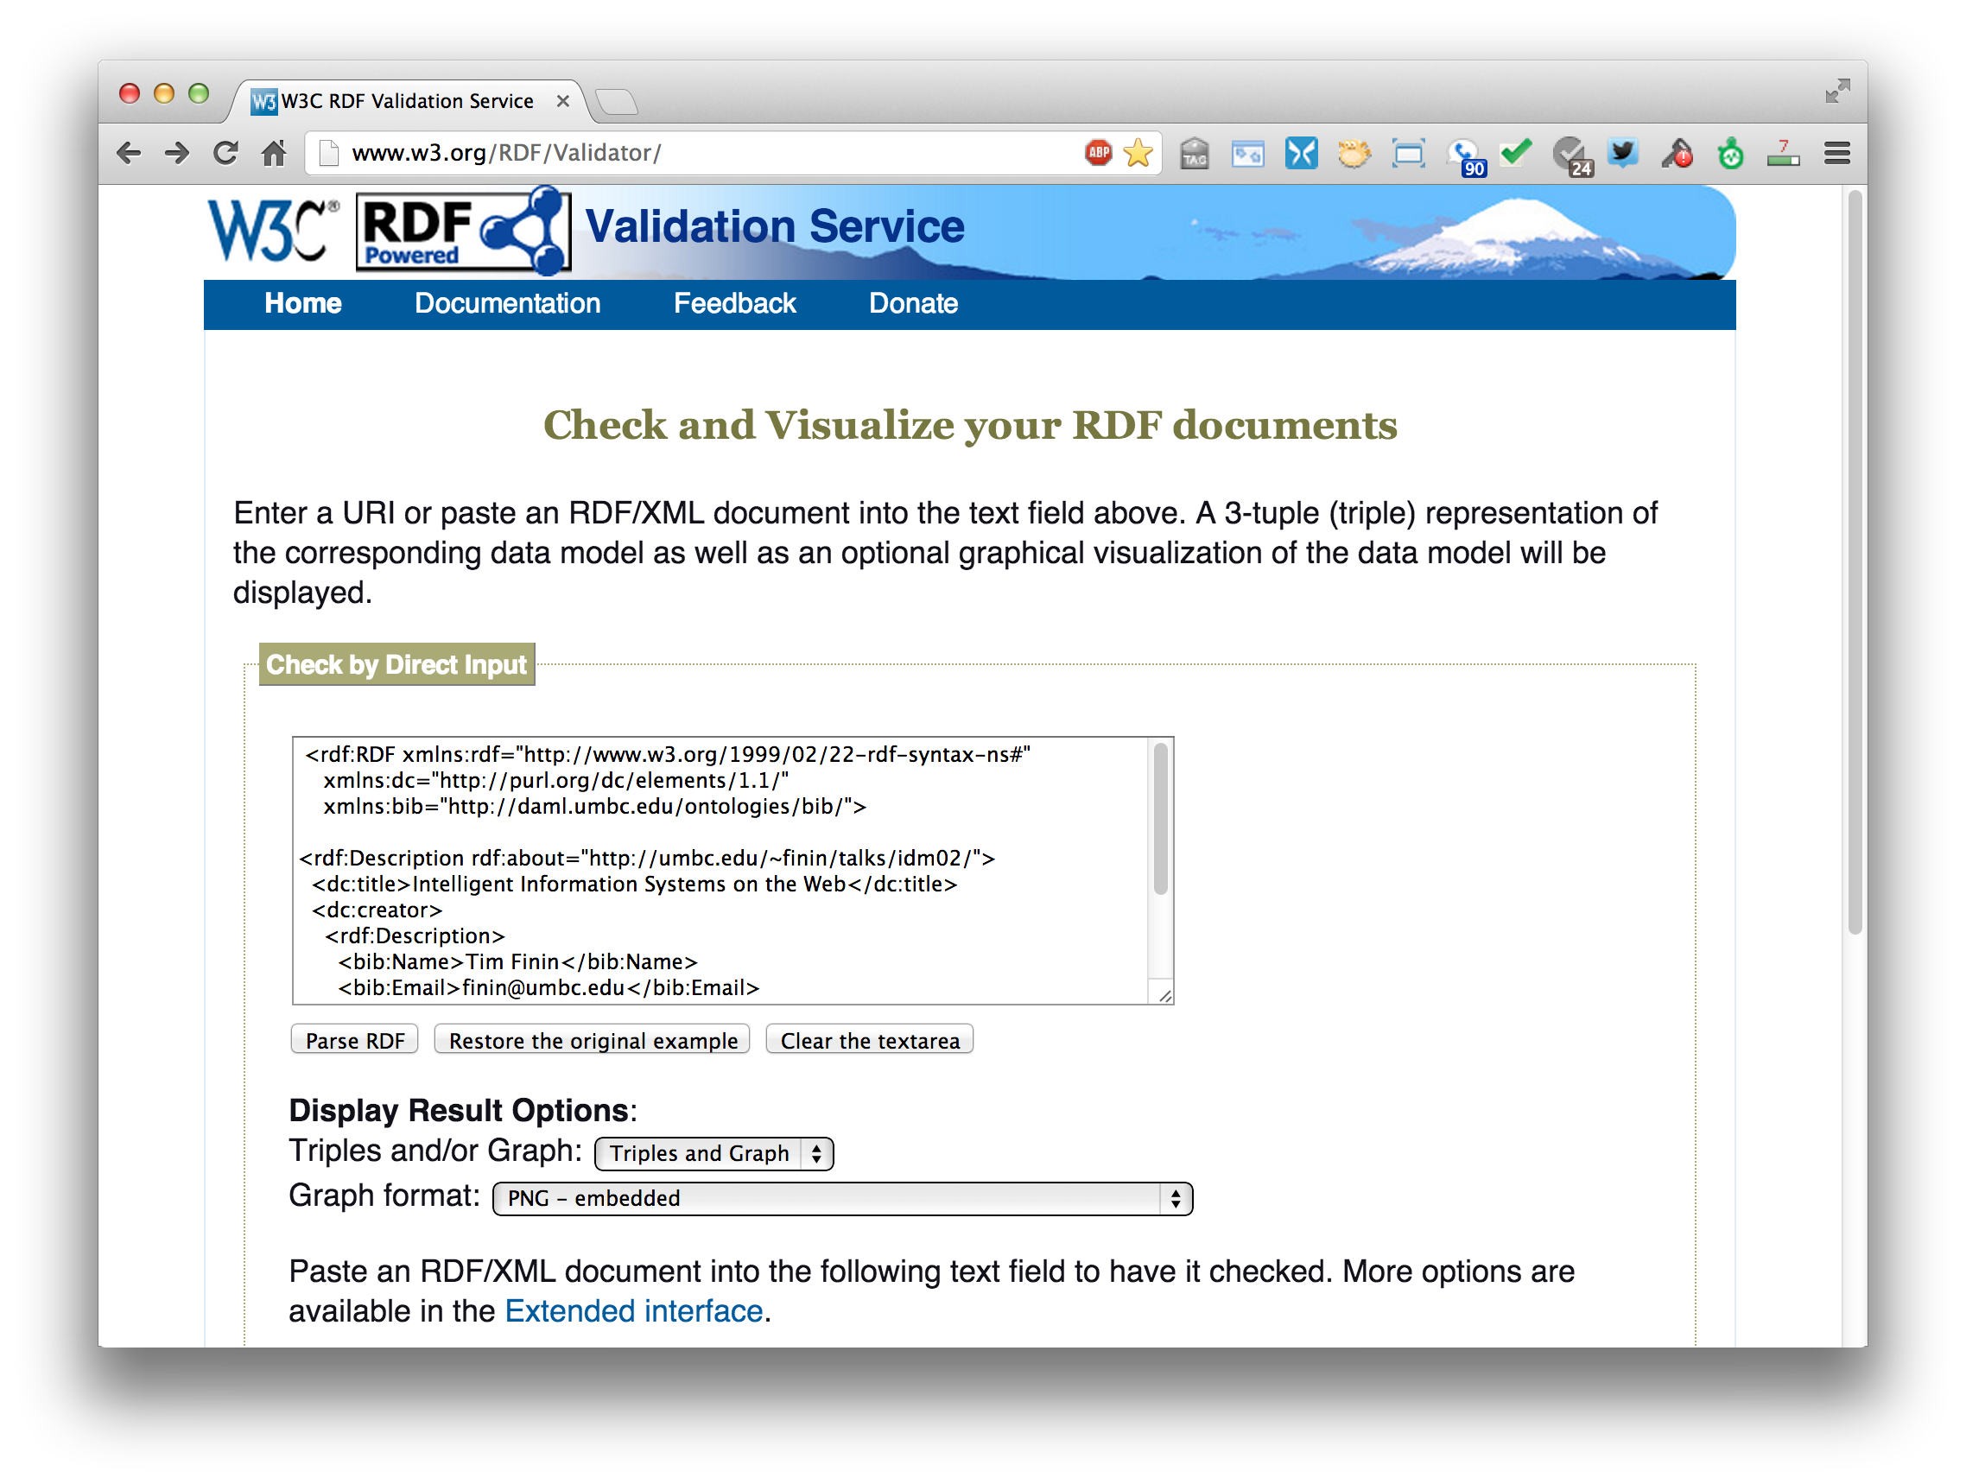
An RDF validation service
http://www.w3.org/RDF/Validator/

Slide 22
Easy to convert between serializations
Most software tools can read and write different serializations
rdf2rdf is a simple handy utility for converting from one RDF serialization to another
Any23 is an open source library, web service and command line tool that extracts structured data in RDF format from a variety of Web documents

Slide 23
N-triple representation
N-triples is a line-oriented serialization for RDF
URIs are wrapped in angle brackets, ended with a period
<subject> <predicate> <object> .
<http://umbc.edu/~finin/talks/idm02/> <http://purl.org/dc/elements/1.1/title> "Intelligent Information Systems on the Web" .
<http://umbc.edu/~finin/talks/idm02/> <http://purl.org/dc/elements/1.1/creator> _:node17i6ht38ux1 .
_:node17i6ht38ux1 <http://daml.umbc.edu/ontologies/bib/Name> "Tim Finin" .
_:node17i6ht38ux1 <http://daml.umbc.edu/ontologies/bib/Email> "finin@umbc.edu" .
_:node17i6ht38ux1 <http://daml.umbc.edu/ontologies/bib/Aff> <http://umbc.edu/> .

Slide 24
Turtle Serialization
Turtle: a compact and readable serialization
# prefix declarations
@prefix rdf: http://www.w3.org/1999/02/22-rdf-syntax-ns# .
@prefix dc: http://purl.org/dc/elements/1.1/ .
@prefix bib: http://daml.umbc.edu/ontologies/bib/ .
<http://umbc.edu/~finin/talks/idm02/>
dc:title "Intelligent Information Systems on the Web" ;
dc:creator
[ bib:Name "Tim Finin” ;
bib:Email finin@umbc.edu ;
bib:Aff: "http://umbc.edu/" ] .

Slide 25
Turtle Syntax
:subj :property1 :value1; :property2 :value2, value3; :property3 :value4.

Slide 26
More RDF Vocabulary
RDF has terms for describing lists, bags, sequences, simple datatypes, etc.
RDF is a “pure” graph representation language
Nodes and edges are simple objects
Both have identifiers that are URIs
Suppose we want to associate a probability with an edge, e.g.,
(:flipper rdf:type :mammal) :probability 0.9
(:flipper rdf:type :fish) :probability 0.1

Slide 27
Property graphs?
RDF is a “pure” graph model with only labeled nodes and edges
Many popular graph databases implement property graphs (e.g., Neo4j)
Nodes & edges can have properties, whose values are literals or maybe lists of literals
Results in a more compact graph
But, as we’ll see, introduces some limitations

Slide 28
More RDF Vocabulary
RDF also can describe triples through reification
Enabling statements about statements
:flipper rdf:type :mammal .
All non-literals have to be URIs
RDF uses prefixes for readability
We can specify what a null prefix means
If we don’t it means “in this file”
https://prefix.cc/ is one service for finding standard prefixes

Slide 29
More RDF Vocabulary
RDF also can describe triples through reification
Enabling statements about statements
:flipper rdf:type :mammal . _:s1 rdf:type rdf:Statement .
_:s1 rdf:subject :flipper .
_:s1 rdf:predicate :type .
_:s1 rdf:object :mammal .
_:s1 :probability 0.9
The underscore prefix is special
It introduces blank nodes
We’ll talk about this in more detail later
For now, think of it as introducing “a new, nameless thing”

Slide 30
More RDF Vocabulary
RDF also can describe triples through reification
Enabling statements about statements
:flipper rdf:type :mammal .
_:s1 a rdf:Statement;
rdf:subject :flipper;
rdf:predicate :type;
rdf:object :mammal;
:probability 0.9 .
Lookup the rdf namespace via https://prefix.cc/
Visit it on the web
You’ll see it defines 18 terms that have special meaning in RDF

Slide 31
More RDF Vocabulary
RDF ABILITY TO describe triples through reification enables statements about statements
:john bdi:believes _:s.
_:s rdf:type rdf:Statement.
_:s rdf:subject <http://ex.com/catalog/widgetX>.
_:s rdf:predicate cat:salePrice .
_:s rdf:object "19.95" .

Slide 32
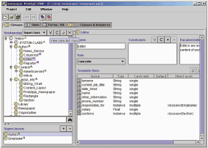
RDF Schema (RDFS)
RDF Schema adds taxonomies for classes & properties
subClass and subProperty
and some metadata.
domain and range constraints on properties
Many widely used KG tools can import and export in RDFS
Stanford Protégé KB editor
Java, open sourced
extensible, lots of plug-ins
provides reasoning & server capabilities

Slide 33
RDFS Vocabulary
RDFS introduces the following terms and gives each a meaning w.r.t. the rdf data model
Terms for classes
rdfs:Class
rdfs:subClassOf
Terms for properties
rdfs:domain
rdfs:range
rdfs:subPropertyOf
Special classes
rdfs:Resource
rdfs:Literal
rdfs:Datatype
Terms for collections
rdfs:member
rdfs:Container
rdfs:ContainerMem-bershipProperty
Special properties
rdfs:comment
rdfs:seeAlso
rdfs:isDefinedBy
rdfs:label

Slide 34
RDF and RDF Schema
Schema-level information
@prefix rdf: http://www.w3.org/1999/02/22-rdf-syntax-ns# . @prefix rdfs: http://www.w3.org/2000/01/rdf-schema# .
@prefix g: http://schema.org/gen .
@prefix u: http://schema.org/univ .
g:name rdf:type rdfs:Property;
rdfs:domain g:Person .
u:Chair rdfs:subclassOf g:Person .
rdfs:Class
rdfs:Property
rdf:type
rdf:type
rdf:type
g:Person
rdfs:domain
rdfs:subclassOf
u:Chair
g:name
Instance-level information
rdf:type
_:john rdf:type u:Chair;
g:name "John Smith" .
g:name
John Smith

Slide 35
RDFS supports simple inferences
New and Improved!
100% Better than XML!!
An RDF ontology plus some RDF statements may imply additional RDF statements
Not true of XML data
Note that this is part of the data model and not of the accessing or processing code
@prefix rdfs: <http://www...>.
@prefix : <…genesis.n3>.
:parent rdfs:domain :Person;
rdfs:range :Person.
:mother
rdfs:subProperty parent;
rdfs:domain :Woman.
:eve :mother :cain.
:parent a rdf:Property.
:Person a rdf:Class.
:Woman rdfs:subClassOf Person.
:mother a rdf:Property.
:eve a :Person;
a :Woman;
:parent :cain.
:cain a :Person.

Slide 36
RDFS Terms
Information on the RDFS vocabulary is given by the file its prefix resolves to
https://www.w3.org/2000/01/rdf-schema
It provides some insight, e.g., rdfs: domain goes from a rdfs:Property to a rdfs:Resource
Not a formal definition though; that’s given in logic

Slide 37
N3 example
Here’s how you declare a namespace.
<> Is an alias for the URI of this document.
This defines the “empty prefix” as refering to “this document”
@prefix rdf: <http://www.w3.org/1999/02/22-rdf-syntax-ns#>.
@prefix rdfs: <http://www.w3.org/2000/01/rdf-schema#>.
@prefix : <#> .
<> rdfs:comment “This is an N3 example”.
:Person a rdfs:Class.
:Woman a rdfs:Class; rdfs:subClassOf :Person.
:eve a :Woman; :age “100”.
:sister a rdf:Property; rdfs:domain :Person; rdfs:range :Woman.
:eve :sister [a :Woman; :age 98].
:eve :believe {:eve :age “100”}.
[is :spouse of [is :sister of :eve]] :age 99.
:eve.:sister.:spouse :age 99.
“person is a class”. The “a” syntax is sugar for rdf:type property.
“Woman is a class and a subclass of person”. Note the ; syntax.
“eve is a woman whose age is 100.”
“sister is a property from person to woman”
“eve has a sister who is a 98 year old woman”. The brackets introduce an anonymous resource.
“eve believes that her age is 100”. The braces introduce a reified triple.
“the spouse of the sister of eve is 99”.
“the spouse of the sister of eve is 99”.

Slide 38
Is RDF(S) better than XML?
Q: For a specific application, should I use XML or RDF?
A: It depends…
XML's model is
a tree, i.e., a strong hierarchy
applications may rely on hierarchy position
relatively simple syntax and structure
not easy to combine trees
RDF's model is
a loose collections of relations
applications may do database-like search
not easy to recover hierarchy
easy to combine relations in one big collection
great for the integration of heterogeneous information

Slide 39
W3C Semantic Web Stack

Slide 40
Problems with RDFS
RDFS too weak to describe resources in detail, e.g.
No localised range and domain constraints
Can’t say that the range of hasChild is person when applied to persons and dog when applied to dogs
No existence/cardinality constraints
Can’t say that all instances of person have a mother that is also a person, or that persons have exactly two parents
No transitive, inverse or symmetrical properties
Can’t say isPartOf is a transitive property, hasPart is the inverse of isPartOf or touches is symmetrical
We need RDF terms providing these and other features.

Slide 41
W3C’s Web Ontology Language (OWL)
DARPA project, DAML+OIL, begat OWL
OWL released as W3C recommendation 2/10/04
See the W3C OWL pages for overview, guide, specification, test cases, etc.
Three layers of OWL are defined of decreasing levels of complexity and expressiveness
OWL Full is the whole thing
OWL DL (Description Logic) introduces restrictions
OWL Lite is an entry level language intended to be easy to understand and implement
Owl 2 became a W3C recommendation in 2009, updated in 2012

Slide 42
OWL ↔ RDF
An OWL document is a set of RDF statements
OWL defines semantics for certain statements
Does NOT restrict what can be said; documents can include arbitrary RDF
But no OWL semantics for non-OWL statements
Adds capabilities common to description logics, e.g., cardinality constraints, defined classes, equivalence, disjoint classes, etc.
Supports ontologies as objects (e.g., importing, versioning, …
A complete OWL reasoning is significantly more complex than a complete RDFS reasoner

Slide 43
OWL ↔ RDF
RDF allows us to define instance-level data
RDFS adds the ability to add some schema-level data
OWL extends this to allow much more schema-level information
We typically use RDFS and OWL to define domain ontologies (i.e., schemas)
And then use those ontologies to state information about instances
Aside: I typically reserve the word ontology to refer to schema definitions. These can include individuals, of course, but often do not.

Slide 44
Embedding Semantic Data in HTML
Embedding semantic data in HTML allows documents to be understood by people and machines
RDFa is a ‘standard’ for embedding RDF in HTML as tag attributes
JSON-LD is a ‘standard’ for embedding RDF in a simple json-compatible serialization
Facebook looks for embedded RDFa state-ments using its opengraph (og) vocabulary
Bestbuy embeds produce info in RDFa

Slide 45
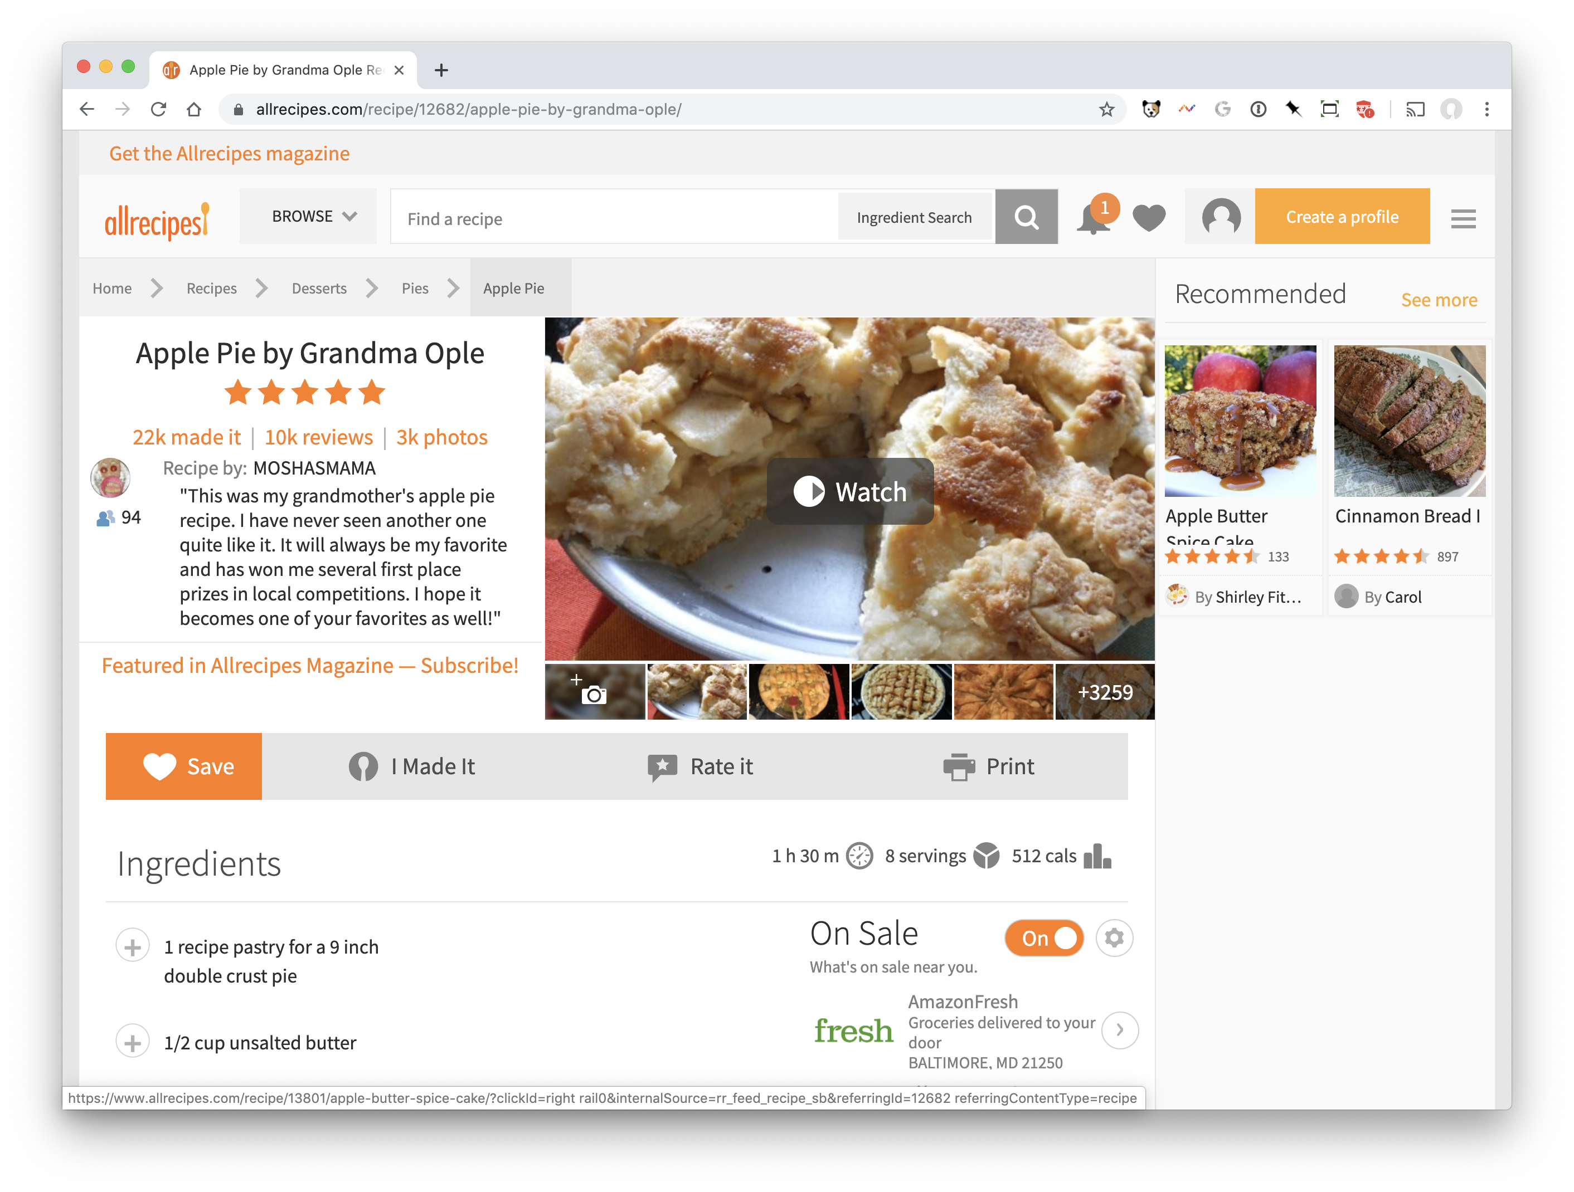
Detecting semantic data via a browser
https://www.allrecipes.com/recipe/12682/apple-pie-by-grandma-ople/

Slide 46
Detecting semantic data via a browser
Structured data sniffer
Shows many kinds of embedded data
Structured data testing
Shows/debugs schema.org
https://www.allrecipes.com/recipe/12682/apple-pie-by-grandma-ople/

Slide 47
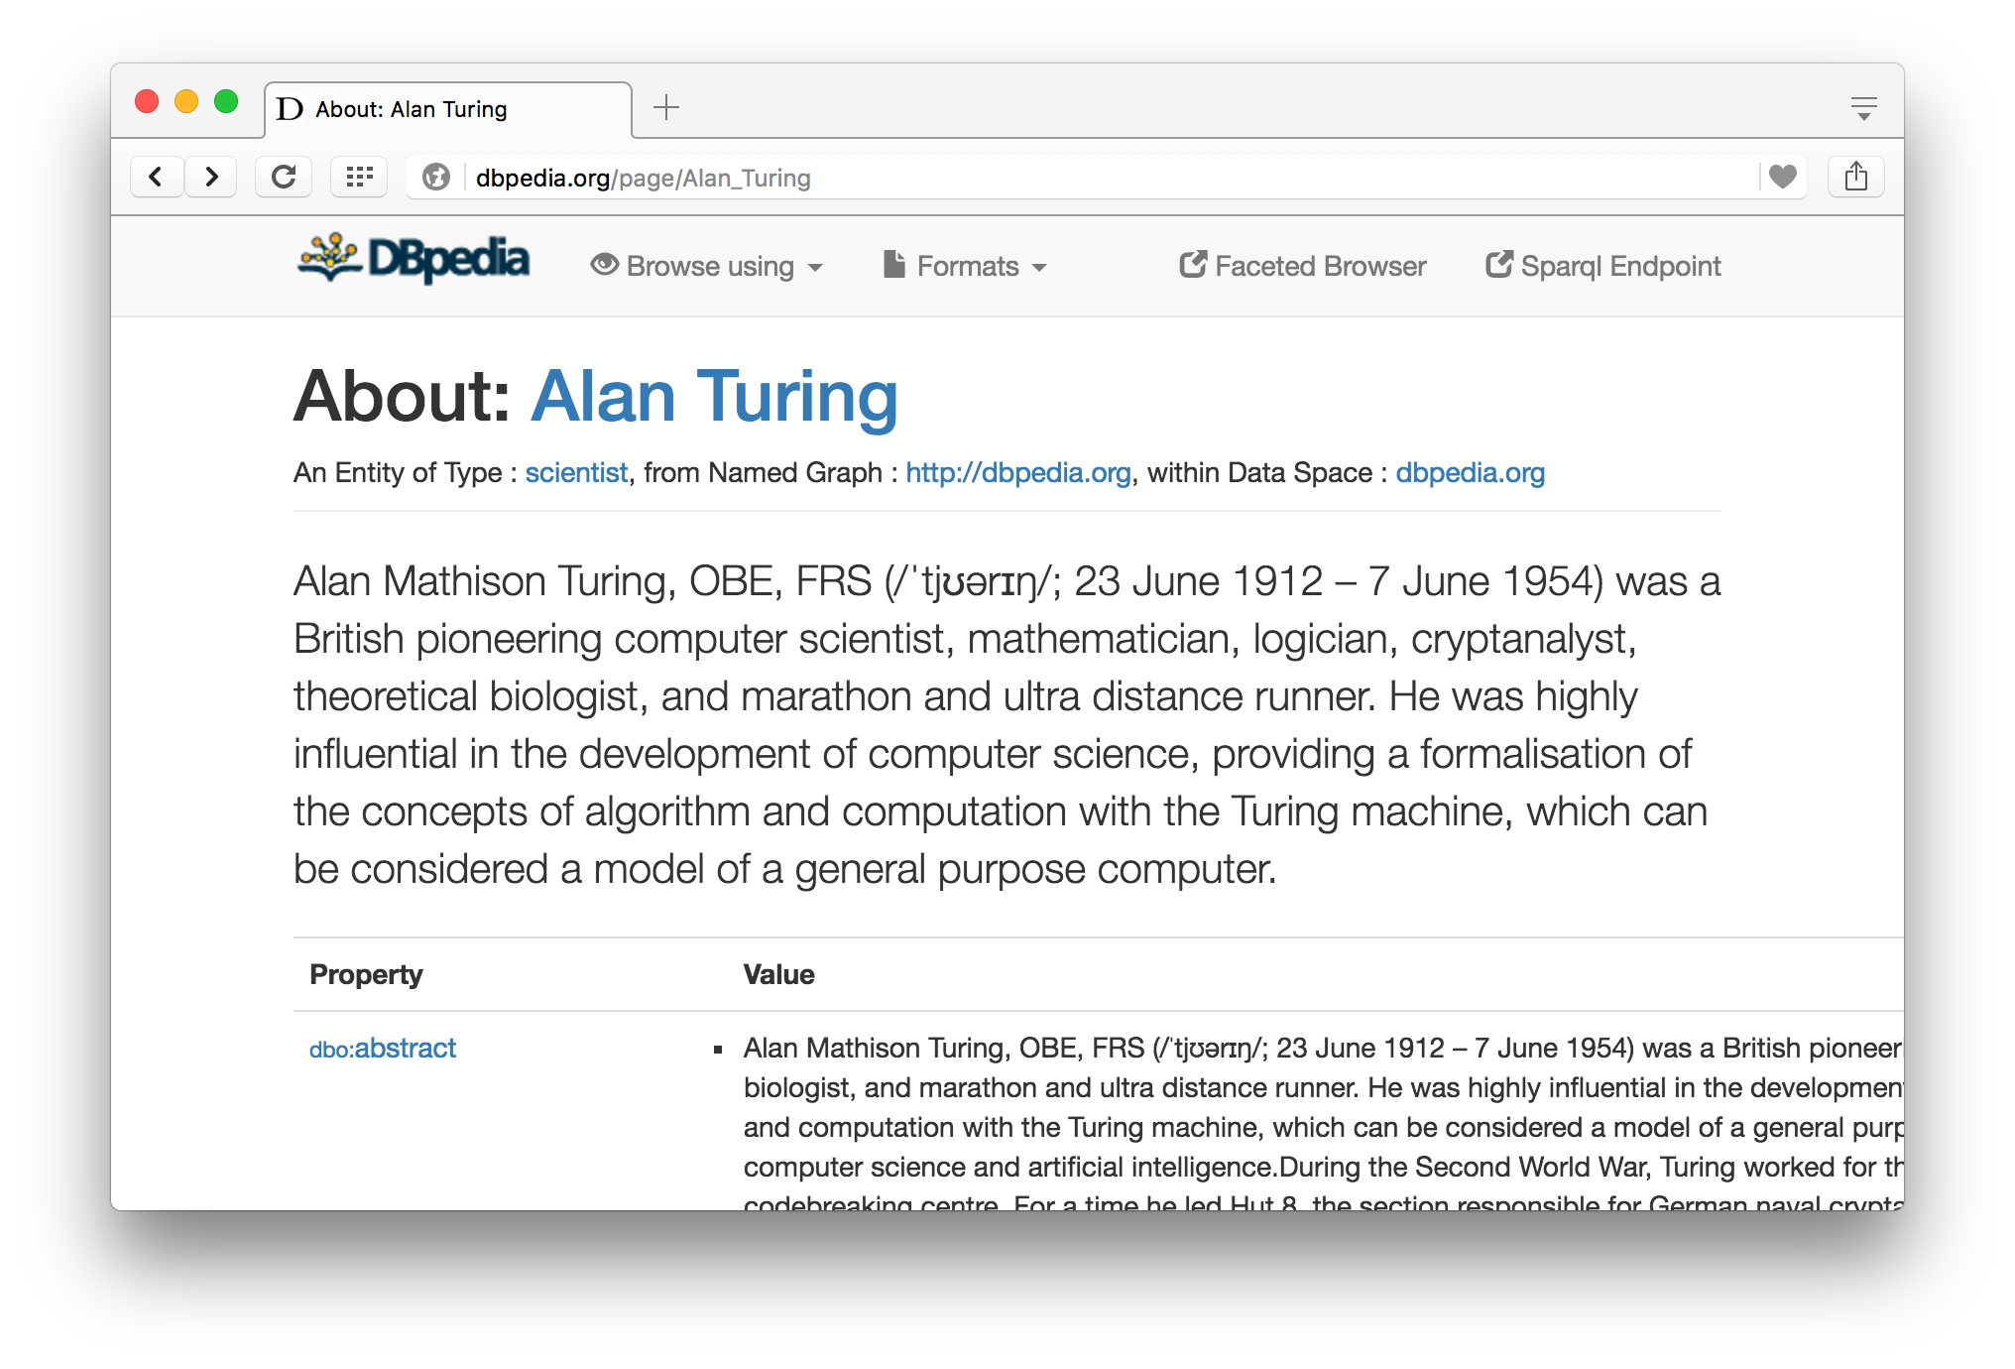
Semantic Data Browser/Query
Notes:
Click on the images to view this page in your browser

Slide 48
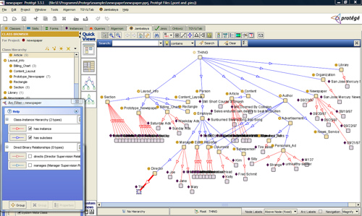
Ontology Editor
There are a number of editors available for creating and editing ontologies and data
We recommend using Protégé, a java-based free system developed at Stanford
Good support for reasoning
Lots of plugins

Slide 49
Triple Stores
A triple store is a database for RDF triples
It usually has a native API and often accepts SPARQL queries
It might do reasoning, either in an eager manner (as triples are loaded) or on demand (to answer queries), etc.
Some stores focus on scalability and others on flexibility and features
We’ll look at several, including Sesame, Apache Jena and stardog

Slide 50
Frameworks and Libraries
There are frameworks, libraries and packages for most programming languages
Jena is a very comprehensive Java framework originally developed by HP and now Apache
Triple store, SPARQL engine, Reasoners, and more
Others are available for Python, Ruby, C#, Perl, PHP, Prolog, Lisp, etc.

Slide 51
Conclusion
There’s quite a bit of technology needed to support the Semantic Web
This has been a brief tour
We’ll cycle back on these and explore them in more detail
And give you a chance to use and experiment with them

